Slide 1
GPTx und RAG in der Praxis
Schluss mit Prototyp
Olliver Zeigermann
Christian Hidber
data2day, Heidelberg, September 2024

Slide 2

Chef: mein Enkel kann das auch…

Slide 3
LLM Intro

Slide 4

Transformers, LLMs, Encoder, Decoder: WTF?
Transformers: A flexible architecture that uses self-attention to process sequential data efficiently.
LLMs: Large-scale Transformer models trained on extensive text datasets to perform various language tasks.
Encoder Models:
Part of the Transformer architecture focused on understanding and interpreting input data (e.g. BERT)
Instrumental for Embedding Models
Decoder Models:
Part of the Transformer architecture focused on generating sequential output based on the interpreted inputs or prior outputs
Instrumental for GPT-style Models like Llama, Mistral or OpenAI GPT

Slide 5
Decoder Models

Slide 6
How does a Decoder Model work ?
Q: what is pluvia ?
Depends on users goal
Unique for each chat & user
Contains the chat history
«the context»
Trained on huge datasets
Does not change
Same for all users
«the model»
Notes:
To bring everyone on the same page here’s a short high-level overview of how decoder models work:
We are given the users input in the form of a string, here the question «what is pluvia»
This string is called «the context»
The context may also contain additioinal instructions for the model, like «answer in french» or «in the style of a medievial aristocrat».
The context string is converted into a sequence of integers. How this is done, we will see in a minute.
The sequence is then processed by the model, yielding an initial hidden state.
Using the hidden state the model generates an output vector containing scores.
Based on these scores the first word of our answer is chosen.
How this selection works in detail, we will also see in a minute.
These words are also called tokens.
To be more prcise: a token is either a word or a word fragment.
For example the word «swimming» contains the 2 tokens «swim» and «ming».
We take our first take and feed it back into the model. Which uses it to update ist hidden state.
The token is also added as the first word to our answer.
The model now – using ist updated hidden state – generates the second output vector.
And again based on ist scores the next token is chosen.
And so on.
Gpt 3 and 4 only need about 50000 tokens to represent an arbitrary string.
Since this is a finite number, we can easily assign to each token a unique id, namely a number between 1 and 50000.
Using these ids we can now easily represent any string as a sequence
And thats how the context was converted into a list of integers at the very beginning.
Since each token has an id – a number between 1 – 50000 – we can use it as an index into the ouput vector.
Thereby assigning to each token a score.
Of course the vectors must have a suitable size, namely 50000.
For example the token with id 3 gets a score of 98 and the one with id 4 -23.
To select the output token, we prefer tokens with a high score.
Thus token with id 3 is much likelier to win then the one with id 3.
More precisely: we convert the output vector to a probability distribution over the token ids using a so-called softmac function.
We then sample from this distribution to get the output token.
There is a common hyperparameter for models called temperature. The temperature simply modifies the distribution.
A high temperture assigns the tokens with a low score a higher probability. Thus the model is likelier to return an «unexpected» or
«surprising» token. Marketing calls this «making the model more creative».
While a low temperature assigns the tokens with a low score even a lower score. Making the selection more deterministic.
Like this we continue until we eventually get an eot or an end-of-text token. Which tells us to stop the generation.
And we end up with the final answer «pluvia is the latin word for rainfall».
These models tend to be really large, typically containing billions or even a trillion parameters.
This poses some particular challenges in bringing them to local hardware.

Slide 7
How does a Decoder Model work ?
A: Pluvia
Q: what is pluvia ?
Pluvia
Depends on users goal
Unique for each chat & user
Contains the chat history
«the context»
Trained on huge datasets
Does not change
Same for all users
«the model»
Single «word»
Depends on context and model
«the token»

Slide 8
How does a Decoder Model work ?
Q: what is pluvia ?
A: Pluvia
is
Depends on users goal
Unique for each chat & user
Contains the chat history
«the context»
Trained on huge datasets
Does not change
Same for all users
«the model»
Single «word»
Depends on context and model
«the token»

Slide 9
How does a Decoder Model work ?
Q: what is pluvia ?
A: Pluvia is
a
Depends on users goal
Unique for each chat & user
Contains the chat history
«the context»
Trained on huge datasets
Does not change
Same for all users
«the model»
Single «word»
Depends on context and model
«the token»

Slide 10
Q: what is pluvia ?
A: Pluvia is a latin
…
Depends on users goal
Unique for each chat & user
Contains the chat history
«the context»
Trained on huge datasets
Does not change
Same for all users
«the model»
Single «word»
Depends on context and model
«the token»

Slide 11
How does a Decoder Model work ?
Q: what is pluvia ?
A: Pluvia is a latin word meaning rainfall.
EOT
Depends on users goal
Unique for each chat & user
Contains the chat history
«the context»
Trained on huge datasets
Does not change
Same for all users
«the model»
Single «word»
Depends on context and model
«the token»

Slide 12


Naïve Approach
You are an expert in …..
What is Pluvia ?
Use the following facts:
User:
Asking a Question
answer
Llm:
Generating an Answer
Notes:
so far we sent the user input directly to the llm.
A typical system architecture looks more like this.
The question is first sent to a so called vector database containing all documents.
Here we search for pages, paragraphs or other text fragments that match the question.
We add them to the input context along with the original question and instructions.
The quality of the answer thus directly depends on the quality of the added text fragments.
To load the database we start with a pile of pdfs.
Here we may need another model taking care of ocr or image recognition to turn the pdfs into text.
If you are in a very privacy sensitive are – like olli in an insurance - we must remove all person-identifying-information,
Like names, social security numbers, adresses and so on. For this you may need yet another model.
The vector database itself is based on yet another model to do the semantic matching between question and document fragments.
All in all there are many different modles collaborating.
To ensure privacy all of them must run on prem.
Building a prototypical system that works «somehow» is one thing,
Building a system that can be operated & maintained over time is a very different story.
Even a small change or update in any of models may have a strong impact on the systems answer quality.
To avoid regressions we must at least be able to evaluate the answers created.
This may be surprisingly difficulty.

Slide 13

Idea: just a few pages
You are an expert in …..
What is Pluvia ?
Use the following facts:
User:
Asking a Question
answer
Llm:
Generating an Answer
Notes:
so far we sent the user input directly to the llm.
A typical system architecture looks more like this.
The question is first sent to a so called vector database containing all documents.
Here we search for pages, paragraphs or other text fragments that match the question.
We add them to the input context along with the original question and instructions.
The quality of the answer thus directly depends on the quality of the added text fragments.
To load the database we start with a pile of pdfs.
Here we may need another model taking care of ocr or image recognition to turn the pdfs into text.
If you are in a very privacy sensitive are – like olli in an insurance - we must remove all person-identifying-information,
Like names, social security numbers, adresses and so on. For this you may need yet another model.
The vector database itself is based on yet another model to do the semantic matching between question and document fragments.
All in all there are many different modles collaborating.
To ensure privacy all of them must run on prem.
Building a prototypical system that works «somehow» is one thing,
Building a system that can be operated & maintained over time is a very different story.
Even a small change or update in any of models may have a strong impact on the systems answer quality.
To avoid regressions we must at least be able to evaluate the answers created.
This may be surprisingly difficulty.

Slide 14
RAG Retrieval Augmented Generation

Slide 15



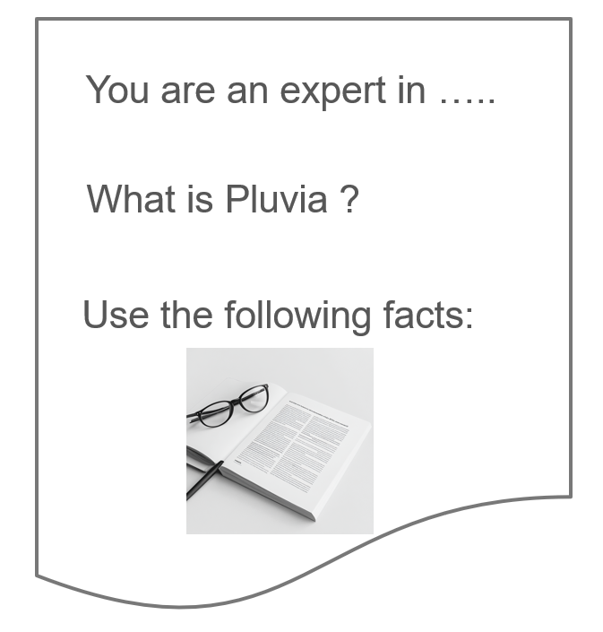
RAG System Architecture
User:
Asking a Question
Doc Loader:
Image2Text
chunks
question
Anonymizer:
Enforcing Privacy
chunks
answer
chunks
Llm:
Generating an Answer
Vector DB:
Searching facts matching
the question
Notes:
so far we sent the user input directly to the llm.
A typical system architecture looks more like this.
The question is first sent to a so called vector database containing all documents.
Here we search for pages, paragraphs or other text fragments that match the question.
We add them to the input context along with the original question and instructions.
The quality of the answer thus directly depends on the quality of the added text fragments.
To load the database we start with a pile of pdfs.
Here we may need another model taking care of ocr or image recognition to turn the pdfs into text.
If you are in a very privacy sensitive are – like olli in an insurance - we must remove all person-identifying-information,
Like names, social security numbers, adresses and so on. For this you may need yet another model.
The vector database itself is based on yet another model to do the semantic matching between question and document fragments.
All in all there are many different modles collaborating.
To ensure privacy all of them must run on prem.
Building a prototypical system that works «somehow» is one thing,
Building a system that can be operated & maintained over time is a very different story.
Even a small change or update in any of models may have a strong impact on the systems answer quality.
To avoid regressions we must at least be able to evaluate the answers created.
This may be surprisingly difficulty.

Slide 16
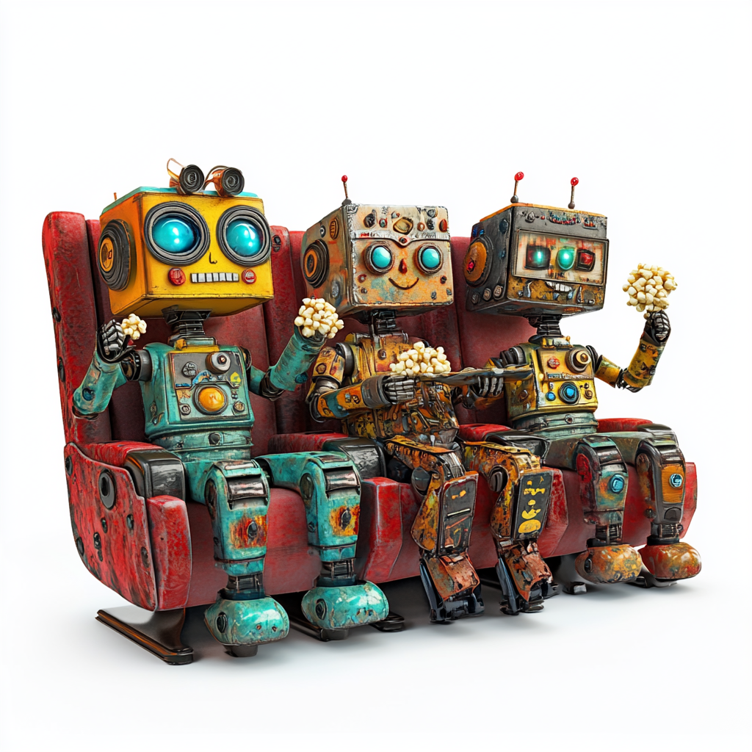
Demo: Low Risk RAG Applications

Slide 17
Choosing an application

Slide 18
Low Risk, but nice benefit
What is the biggest risk we are facing?
What is the worst thing that could happen and how to mitigate that?
Choose something that is low risk, but nice benefit
Low profile
Failures should be ok
Let the whole organization learn
Management likes it, but is afraid

Slide 19
From Prompt Hacking to Production

Slide 20
Der kleine Heimwerker vs Ingenieur Tätigkeit
hohes Maß an Automatisierung
Generalisierung: Modell auf zukünftige Daten verallgemeinert anwendbar?
Der Nutzen ergibt sich durch Vorhersage auf bisher unbekannten Daten in der Zukunft.​
Auf diesen muss das Modell eine gute Leistung bringen. Nur das ist relevant.​
über einen längeren Zeitraum stabil bleiben
Beispiel LLM und Prompting - können wir das nicht alle?
Von wqelcher Art Prompting sprechen wir ? Muss man unterscheiden von ad hoc Prompting
Bei Ad hoc sieht man direkt, ob es geht. Man hat ein hohes Maß an menschlicher Überwachung.
Unterschied internes Werkzeug und stabiler Service. Plattform Team

Slide 21
Evaluation

Slide 22

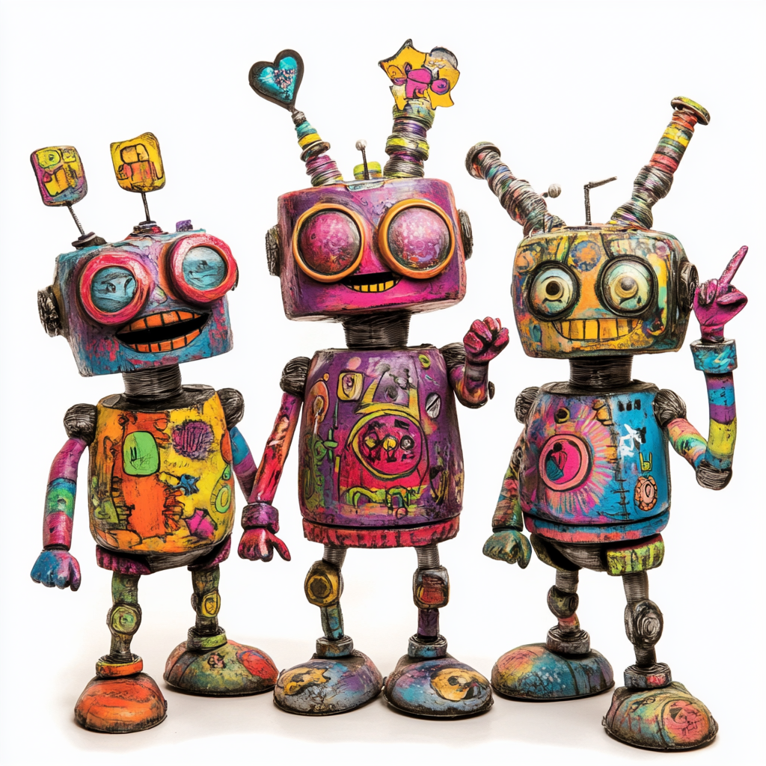
Evaluation on text results
User:
Asking a Question
Question
What is Pluvia ?
Answer
Pluvia is a latin word meaning rainfall.
The latin word for rainfall.
….
=> equality not an option
answer
Human Eval
Llm:
Generating an Answer
Notes:
When you a send the same model the same question twice, you may well get 2 different answers.
And both maybe valid.
To decide if a generated answer is okay, we can’t compare to a reference anymore.
This makes Unit testing, detecting regressions or debugging may get quite painful.
Comparing the impact of an model change - for example due to quantization – also becomes a real headache.
In a nutshell: equality testing is not an option anymore.
A good but expensive way is to ask humans to do the evaluation.
This is great to build up the gut feeling.
But who wants to become a part of a build-pipeline ?
Even when you have a few interns at hand, you need a set of criteria.
For example an answer may be correct but written in an unprofessional style.
Note that we don’t always need a ground-truth – meaning a “true reference answer”.
For example we often can detect contradictions without knowing the “real truth”.
People tried for quite a while to use statistics. But this did not work very well.
They key idea is to ask a model to evaluate each criteria separately.
Thus turning the llm into a judge.

Slide 23
Evaluation on text results
Evaluation Criteria:
Correct
Complete
Concise
Relevant
Contradiction free
Language
Style
…
Generation successful
User:
Asking a Question
answer
Ground Truth
Human Eval
Statistics
Llm:
Generating an Answer

Slide 24
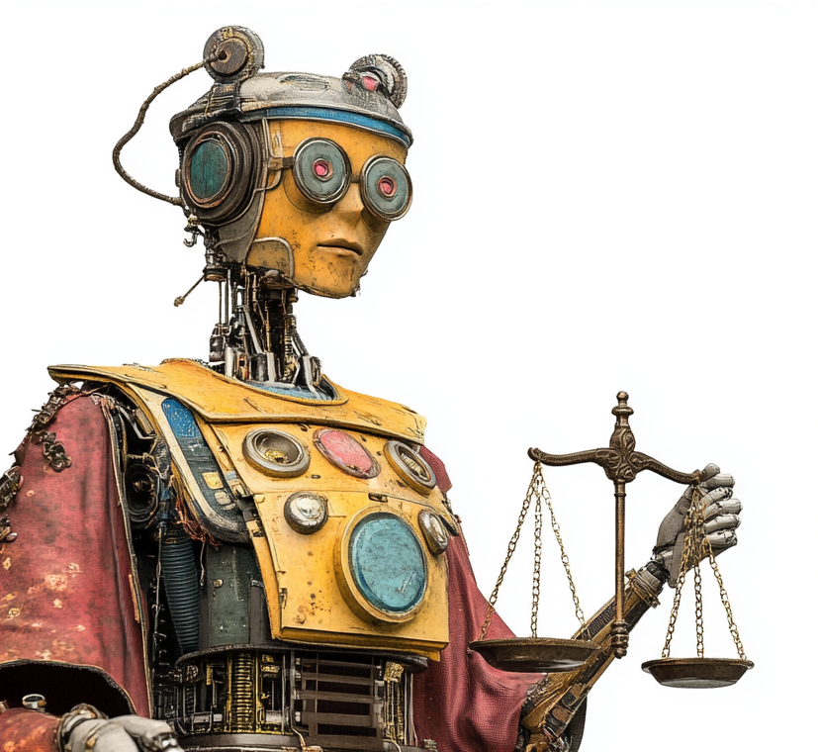
Evaluation on text results
Evaluation Criteria:
Correct
Complete
Concise
Relevant
Contradiction free
Language
Style
…
Generation successful
User:
Asking a Question
answer
LLM as a Judge
Ground Truth
Human Eval
Statistics
Llm:
Generating an Anwer

Slide 25
LLM as a judge: Idea
Generation
Llm Input : “Why do you dislike writing texts ?”
Llm Output : «Witing texts is painful, caus im making mitakes.”
Context
You are an expert on english language. Grade a students text with scores between 0 and 10.
Answer with a Json containing a score and a reason.
Student Text: Witing texts is painful, caus im making mitakes.
Json:
Result
{
'score’: 2,
'reason’: "The text contains multiple spelling errors, such as 'Witing' instead of 'Writing.“
}
Notes:
Given the input and output of the last llm call we use a handcrafted prompt that asks the eval to do the grading.
Besides the prompt, the input & output are of course also included in the context that we send to the model.
In the prompt we also ask for a json containing a score between 0 and 10 and a reason for the score.

Slide 26
Demo: Evaluation Notebook

Slide 27
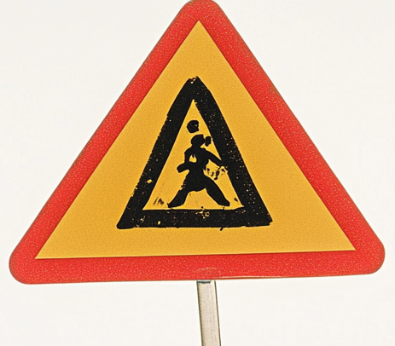
RAG System Architecture
User:
Asking a Question
Doc Loader:
Image2Text
chunks
question
Anonymizer:
Enforcing Privacy
chunks
answer
SystemPrompt
Question
Chunks
chunks
Llm:
Generating an Answer
Vector DB:
Searching facts matching
the question
Notes:
so far we sent the user input directly to the llm.
A typical system architecture looks more like this.
The question is first sent to a so called vector database containing all documents.
Here we search for pages, paragraphs or other text fragments that match the question.
We add them to the input context along with the original question and instructions.
The quality of the answer thus directly depends on the quality of the added text fragments.
To load the database we start with a pile of pdfs.
Here we may need another model taking care of ocr or image recognition to turn the pdfs into text.
If you are in a very privacy sensitive are – like olli in an insurance - we must remove all person-identifying-information,
Like names, social security numbers, adresses and so on. For this you may need yet another model.
The vector database itself is based on yet another model to do the semantic matching between question and document fragments.
All in all there are many different modles collaborating.
To ensure privacy all of them must run on prem.
Building a prototypical system that works «somehow» is one thing,
Building a system that can be operated & maintained over time is a very different story.
Even a small change or update in any of models may have a strong impact on the systems answer quality.
To avoid regressions we must at least be able to evaluate the answers created.
This may be surprisingly difficulty.

Slide 28
RAG System Architecture: Online Evaluation
User:
Asking a Question
Doc Loader:
Image2Text
chunks
question
Answer Relevance
Conciseness
Contextual Relevance
chunks
Anonymizer:
Enforcing Privacy
answer
SystemPrompt
Question
Chunks
chunks
Llm:
Generating an Anwer
Vector DB:
Searching facts matching
the question
Faithfulness
Notes:
Since all models belonging to our system may have a strong impact, we not only evaluate the generated answer, but also the
Chunks or text fragments provided by the vector db.
Hence we can check if the content of generated answer is actually grounded by the information contained in our documents.
Or we can track if the database produces results that are relevant for the users question.
Having all these evaluations available makes it much easier to discover, why a system does not work as expected.
Moreover we can run these evaluations online, yielding a continuous monitoring of the involved llms.

Slide 29
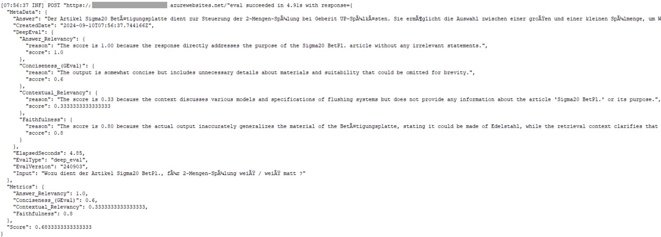
Online Eval: Example

Slide 30
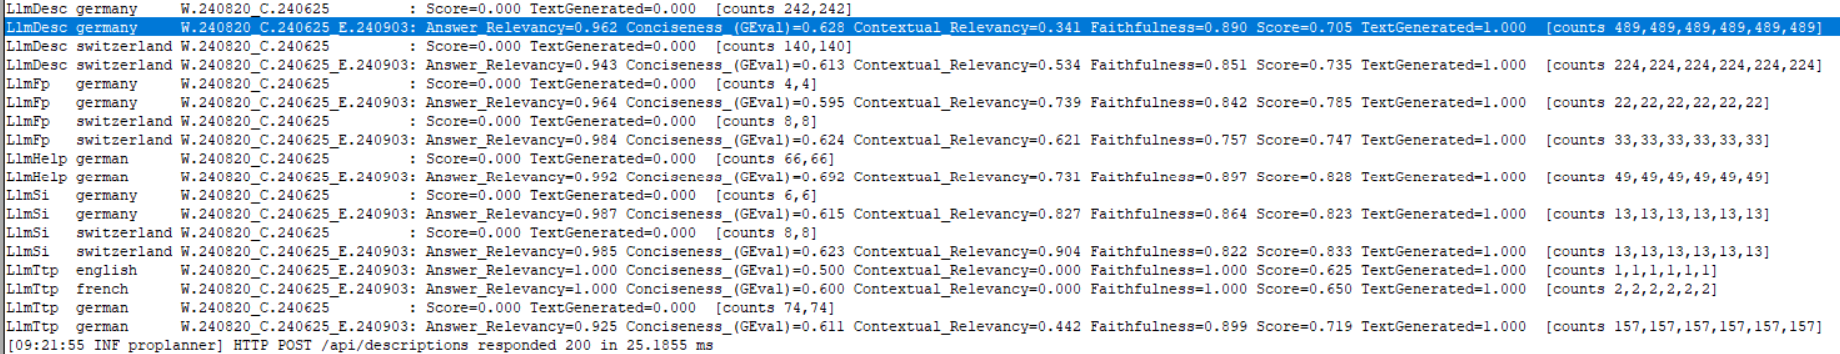
Online Eval: Example

Slide 31
Evaluation Issues
Online Performance impact on LLM
Eval may call 10x more often, but have less output tokens
Which LLM do you use ? Same ? Faster ? Most Powerful ?
What Dimensions do you eval ?
Toxicity, Conciseness, Answer Relevance ?
Ground Truth available ?
Human Feedback from your users ?
Interpretation of the Scores ?

Slide 32
Eval Frameworks
DeepEval https://docs.confident-ai.com/
Ragas https://ragas.io/
TruLens https://www.trulens.org/
Evidently https://www.evidentlyai.com/
Ares https://ares-ai.vercel.app/
…

Slide 33
Your Experience ?
Anyone doing RAG ? In Production ?
Do you do evaluation ? By humans ?
What else do you use for evaluation ?

Slide 34
Wrap Up

Slide 35
Key takeaways
Human Eval is a great starting point
LLM-as-a-Judge works, but take the scores with a grain of salt
Use a strong LLM for evaluation
Evaluation is even more crucial when using potentially less powerfull models
Getting the Documents & keeping the up-to-date can be painful
Vorsicht vor dem Enkel des Chefs…

Slide 36
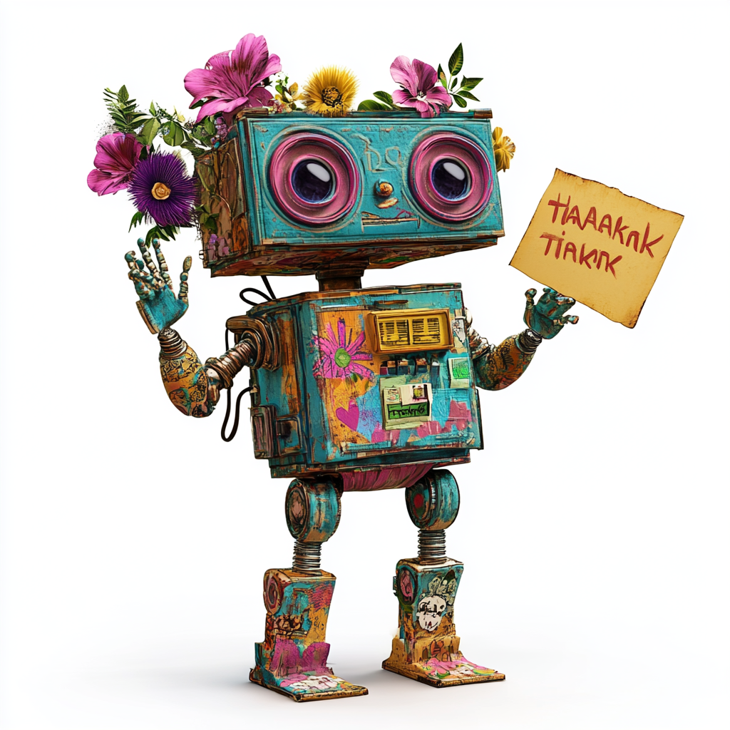
Thank you

